Slide 1


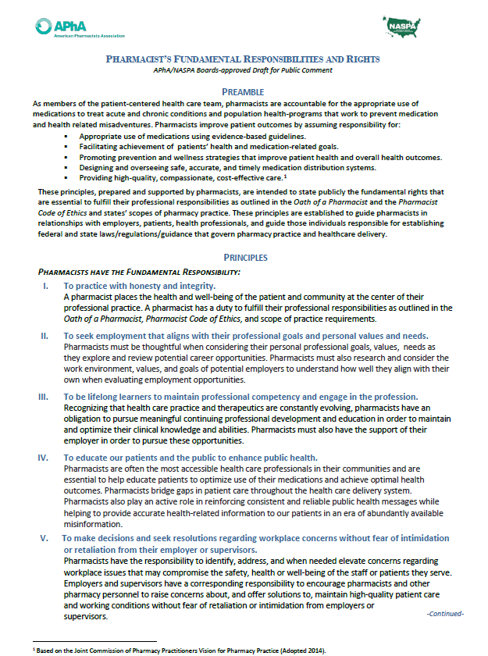

Pharmacists’ Fundamental Responsibilities & Rights
Working Them Into Your Career Conversations
For Every Pharmacist. For All of Pharmacy.
pharmacist.com

Slide 2
Overview
Discuss the purpose of the Fundamentals document and how it was developed
Review each responsibility and rights principle
Introduce a conversation framework useful for engaging others
Review exemplar discussion points

Slide 3
Pharmacist’s Fundamental Responsibilities & Rights
What is the Fundamentals?
Set of principles built upon oath of & code of ethics for pharmacists
Outline responsibilities assumed & corresponding support needed to fulfill
Apply to an array of practice areas where pharmacists are employed
Designed to address practice and workplace issues & concerns

Slide 4
Background – History of Development
Timeline for Development
Summer 2019 - consensus conference recommendations directed towards ‘regulators’
Fall 2019 - APhA’s Well-being Steering Committee (WBSC) formed
Oct. 2020 - APhA/NASPA appointed small action-oriented workgroup
Jan 2021 - Workgroup plan of action submitted for board(s) approval

Slide 5
Background – History of Development
Work Products Developed
Pharmacist’s Fundamental Responsibilities & Rights
Pharmacy Workplace & Well-being Reporting Portal (PWWR)
APhA/NASPA State-based National Survey

Slide 6
Background – History of Development
Work Products Developed
Pharmacist’s Fundamental Responsibilities & Rights
Pharmacy Workplace & Well-being Portal (PWWR)
APhA/NASPA State-based National Survey

Slide 7
Fundamental Responsibilities
Review of Principles
What Improves Patient Outcomes

Slide 8

I. Practice with honest & integrity
Pharmacists have the fundamental responsibility to:

Slide 9

II. Seek employment that aligns with professional goals & personal needs & values
Pharmacists have the fundamental responsibility to:

Slide 10
Know prospective employers
Goals
Values
Climate
Culture
…Seek employment that aligns w/ professional goals & personal needs and values.

Slide 11
III. Be lifelong learners to maintain professional competence and engage in the profession
Pharmacists have the fundamental responsibility to:

Slide 12
IV. Educate their patients and the public to enhance public health
Pharmacists have the fundamental responsibility to:

Slide 13
V. Make decisions & seek resolutions regarding workplace concerns without fear of intimidation or retaliation from their employer or supervisor
Pharmacists have the fundamental responsibility to:

Slide 14
I. Practice with honest & integrity
II. Seek employment aligned to professional goals/personal values & needs
III. Be lifelong learners
IV. Educate their patients & public to enhance public health
V. Make decisions & seek resolutions regarding workplace concerns without fear
Pharmacists have the fundamental responsibility to:

Slide 15
Fundamental Rights
Review of Principles
What is Required for Pharmacists to Fulfill Their Professional Responsibilities.

Slide 16
I. Practice pharmacy in the best interest of patient and community health & well-being
Pharmacists have the fundamental right to:

Slide 17
II. Exercise professional judgment under the auspices of their license when delivering care to patients
Pharmacists have the fundamental right to:

Slide 18
III. Be treated in a considerate, respectful, & professional manner by patients & supported by employers & supervisors
Pharmacists have the fundamental right to:

Slide 19
IV. A workplace free of racism, discrimination, bullying, or harassment, as well as physical, verbal, or emotional abuse.
Pharmacists have the fundamental right to:

Slide 20

V. A working environment where the necessary resources are allocated to provide both legally required patient care services & any additional patient care services offered
Pharmacists have the fundamental right to:

Slide 21
VI. Reasonable working hours & conditions
Pharmacists have the fundamental right to:

Slide 22
VII. Have a voice in the development of metrics, & how those metrics are used as criteria for performance evaluations of all pharmacy staff
Pharmacists have the fundamental right to:

Slide 23
I. Practice in best interest of patient/community health & well-being
II. Exercise professional judgment
III. Be treated well by patients & supported by employers & supervisors
IV. A workplace free of discriminatory practices & abuse
V. A working environment with necessary resources for all care services
VI Reasonable working hours & conditions
VII. Have input in development performance measurements for pharmacy staff evaluation
Pharmacists have the fundamental right to:

Slide 24
Conversation Preparedness
Open – Describe – Explain - Repair
A Framework to Address Difficult Situations

Slide 25
O ● D ● E ● R
OPEN the conversation & disarm potential for conflict
DESCRIBE what happened
EXPLAIN the impact
REPAIR (RECOMMIT)
Used with permission from MJ Negrete. Pharmacy Leadership and Education Institute 2023.

Slide 26
O D E R
Open the Conversation
Explain the Impact
Repair
Describe What Happened
Used with permission from MJ Negrete. Pharmacy Leadership and Education Institute 2023.

Slide 27
O D E R
Open the Conversation
Explain the Impact
Repair
Describe What Happened
Used with permission from MJ Negrete. Pharmacy Leadership and Education Institute 2023.

Slide 28
O D E R
Open the Conversation
Describe What Happened
Explain the Impact
Repair
Used with permission from MJ Negrete. Pharmacy Leadership and Education Institute 2023.

Slide 29
O D E R
Open the Conversation
Describe What Happened
Explain the Impact
Repair/ Recommit
Used with permission from MJ Negrete. Pharmacy Leadership and Education Institute 2023.

Slide 30
O D E R
Open the Conversation
Describe What Happened
Explain the Impact
Repair
Used with permission from MJ Negrete. Pharmacy Leadership and Education Institute 2023.

Slide 31
Situations & Scenarios
Fundamental Right III: To be treated in a considerate, respectful, and professional manner by patients and supported by employers and supervisors
Mr. Carmichael was informed that his opioid prescription would be ready in 10 minutes after needed clarification from the prescriber was received only 10 minutes ago. He had been notified that clarification was sought, and a delay was possible via text and as a courtesy via text. Mr. Carmichael was enraged. The store manager apologized for the pharmacist’s actions. The pharmacist noticed the patient has sleep apnea and may not tolerate the opioid increase.

Slide 32

Applying O-D-E-R
Open the Conversation & Defuse Potential Conflict:
“I would like to speak to you about the incident involving Mr. Carmichael today. When would be best time for you?
Describe the Situation:
“Mr. Carmichael was informed that his Rx would be ready in 10 minutes. Needed clarification from the prescriber was received only 10 minutes before that. Marc sought prescription clarification because of a potential adverse event and notified the patient.
Mr. Carmichael was enraged and expressed verbally to Marc when he explained why the prescription was not finished upon his arrival. You apologized for Marc’s actions ”
Fundamental Right III: To be treated in a considerate, respectful, and professional manner by patients and supported by employers and supervisors

Slide 33
Applying O-D-E-R
Explain the Impact:
“Mr. Carmichael’s volatile response felt scary to Marc. Marc felt stunned that an apology was offered to him by you because he called the prescriber to clarify what was on the prescription as a matter of medication safety. In fact, the prescriber did make a mistake and thanked Marc for noticing.
Repair/Recommit:
“Marc’s action on behalf of Mr. Carmichael was made with his best interest in mind. The potential adverse event is serious. What do you think you could do to make it right with Marc, who was exercising professional judgment? Can we count on you to support our professional judgements?
Fundamental Right III: To be treated in a considerate, respectful, and professional manner by patients and supported by employers and supervisors

Slide 34
Situations & Scenarios
Fundamental Right V: To a working environment where the necessary resources are allocated to provide both legally required patient care services, as well as any additional enhanced patient care service offered.
The state association in conjunction with the local health department wishes to distribute naloxone through community pharmacies. A community pharmacy has signed up to participate in the program. There is concern amongst pharmacy personnel about the added workload.

Slide 35
Applying O-D-E-R
Open the Conversation & Defuse Potential Conflict:
“Before your visit to the store ends, would it be possible to talk about the naloxone distribution initiative we read about in the weekly bulletin, unless there is a more convenient time for you this week?”
Describe the Situation:
“The naloxone distribution initiative in the weekly bulletin lists a start date. What it does not describe is the expected, incremental workload, the length of time, or resources that will be added to ensure a successful launch.”
Fundamental Right V: To a working environment where the necessary resources are allocated to provide both legally required patient care services, as well as any additional enhanced patient care service offered.

Slide 36
Applying O-D-E-R
Explain the Impact:
“Pharmacy personnel are experiencing anxiety as the weekly bulletin introduces a level of uncertainty as it is unclear how this important public health initiative will be accomplished with the resources were have today.”
Repair/Recommit:
“What can we count on to address the uncertainty related to this initiative? What resources can we count on or what can we agree we can stop doing to refocus our effort on distributing naloxone here. What and when can I share this information with other pharmacy personnel?”
Fundamental Right V: To a working environment where the necessary resources are allocated to provide both legally required patient care services, as well as any additional enhanced patient care service offered.

Slide 37
Situations & Scenarios
Fundamental Right I: To practice pharmacy in the best interest of patient and community health and well-being
Technician & intern hours have been suddenly cut by 20% with no reason cited. This is to occur starting next week.

Slide 38
Applying O-D-E-R
Open the Conversation & Ask Permission:
“I want to discuss the unexpected reduction in technician and intern hours.
When may I get on your calendar this week?”
Describe the Situation:
“A 20% reduction in technician and intern hours starts next week. There does not appear to be a reason. Pharmacy personnel adjusted reasonably well to a recent reduction due budgetary constraints, though there have been several near miss medication error situations in the last few weeks.”
Fundamental Right I: To practice pharmacy in the best interest of patient and community health and well-being

Slide 39
Applying O-D-E-R
Explain the Impact:
“Pharmacy personnel worry that a medication error is going to happen. This has decreased our operational efficiency as pharmacists are practicing with fear of not catching mistakes and feel disappointment as they finally adjusted reasonably well to the last, expected reduction in hours.”
Repair/Recommit:
“Pharmacists want to deliver high quality patient care and protect patients from medication error. What support can you commit to mitigate the fear of committing a medication error and potentially harming a patient? What can be counted upon?”
Fundamental Right I: To practice pharmacy in the best interest of patient and community health and well-being

Slide 40
Situations & Scenarios
Considering Employment Opportunities

Slide 41
Seeking to change positions
Mary is considering a new position. Her current employer appears focused on non-patient care initiatives. She appreciates that the pharmacy needs to be fiscally sound, and she wants to focus on the patient more than she can now. What can Mary ask to avoid being with a similar employer?
Fundamental Responsibility II: To seek employment that aligns with their professional goals and personal values and needs.

Slide 42
What Mary can ask?
I am interested in increasing engagement with patients…
Describe for me your approach to patient care services & provide a specific example of a patient encounter.
How would you characterize the percentage of time spent on patient care activities. How are resources allocated & how is other work completed (and by whom)?

Slide 43
Offered a ‘dream’ position – now what?
Michael has been offered a position that aligns to his goal to delivery patient care services in his community. The employer’s mission and vision excite him as well. What can Michael ask to deepen his understanding of his potential employer?
Fundamental Responsibility II: To seek employment that aligns with their professional goals and personal values and needs.

Slide 44
What Michael can ask?
Your vision, mission, and this job description align with
what is important to me. I would like a little more about
the company.
Describe the approach to adding new patient services. How are they resourced? How is success measured? How is staff supported?
When a new service being considered, tell me about how input is solicited from pharmacy personnel?
How does staffing to ensure patient safety look?

Slide 45
Pharmacists’ Fundamental Responsibilities & Rights
Working Them Into Your Career Conversations
www.pharmacist.com/wellbeing
For Every Pharmacist. For All of Pharmacy.
pharmacist.com

